Slide 1
Lab 5 Measuring a refractive index
By Daksh Khandelwal

Slide 2
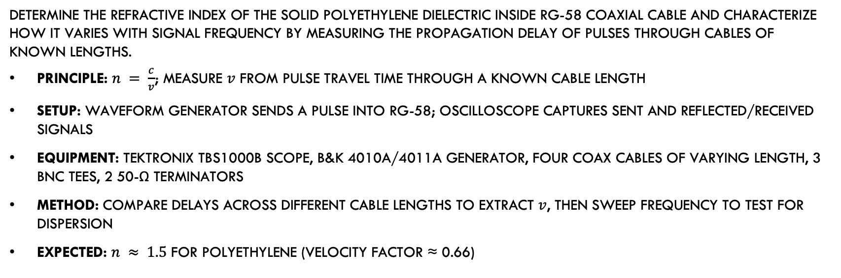
Objective and Experiment
Determine the refractive index of the solid polyethylene dielectric inside RG-58 coaxial cable and characterize how it varies with signal frequency by measuring the propagation delay of pulses through cables of known lengths.
Principle: $n = \frac{c}{v}$; measure $v$ from pulse travel time through a known cable length
Setup: waveform generator sends a pulse into RG-58; oscilloscope captures sent and reflected/received signals
Equipment: Tektronix TBS1000B scope, B&K 4010A/4011A generator, four coax cables of varying length, 3 BNC tees, 2 50-Ω terminators
Method: compare delays across different cable lengths to extract $v$, then sweep frequency to test for dispersion
Expected: $n ≈ 1.5$ for polyethylene (velocity factor ≈ 0.66)

Slide 3
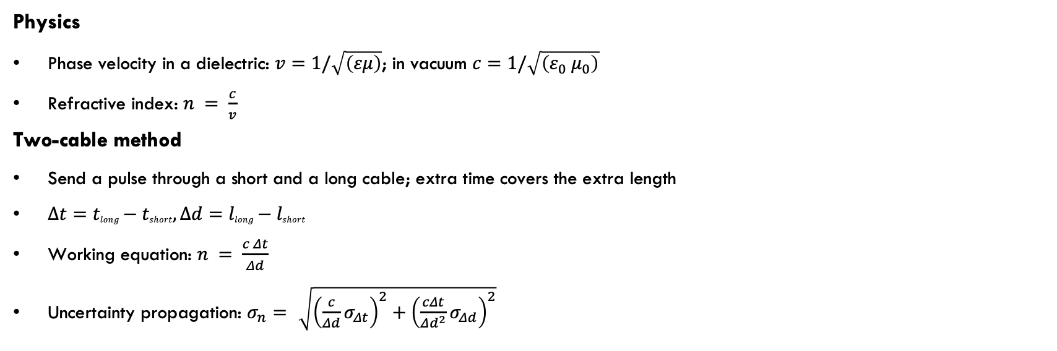
Physics and Method
Physics
Phase velocity in a dielectric: $v=1/\sqrt{\left(εμ\right)}$; in vacuum $c=1/\sqrt{\left(ε_{0} μ_{0}\right)}$
Refractive index: $n = \frac{c}{v}$
Two-cable method
Send a pulse through a short and a long cable; extra time covers the extra length
$Δt=tlong−tshort,Δd=llong−lshort$
Working equation: $n = \frac{c Δt}{Δd}$
Uncertainty propagation: $σ_{n}=\sqrt{{\left(\frac{c}{Δd}σ_{Δt}\right)}^{2}+{\left(\frac{cΔt}{Δd^{2}}σ_{Δd}\right)}^{2}}$

Slide 4
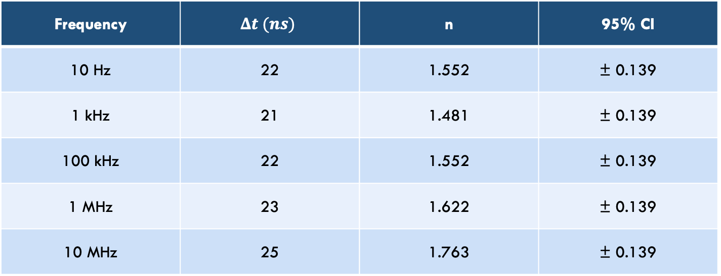
Data and Measurements
Cable lengths: $L_{short}=185±1 \text{cm}$, $L_{long}=610±1 \text{cm}→Δd=425 \text{cm}$ $\left(σ_{Δd}=\sqrt{2} \text{cm}\right)$ Oscilloscope: Cursor uncertainty $σ_{Δt}=1 \text{ns}$
Frequency | $$Δt (ns)$$ | n | 95% CI
10 Hz | 22 | 1.552 | ± 0.139
1 kHz | 21 | 1.481 | ± 0.139
100 kHz | 22 | 1.552 | ± 0.139
1 MHz | 23 | 1.622 | ± 0.139
10 MHz | 25 | 1.763 | ± 0.139
Each $σ_{n}$ is dominated by the $±1$ ns $Δt$ read uncertainty (>99% of variance). The $σ_{Δd}$ contribution is negligible at this $Δd$.

Slide 5


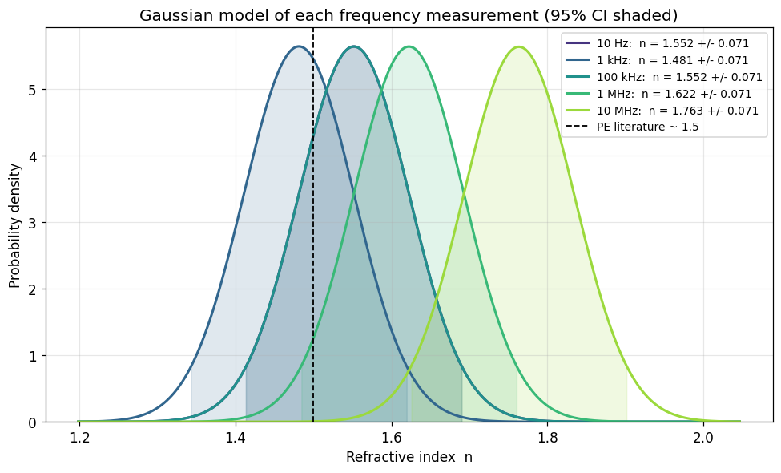

Results: Per-Frequency Measurements
Each measurement modeled as $n\left(nᵢ,σᵢ^{2}\right)$: a gaussian centered on $nᵢ$ with width $σ_{n}$
Shaded band is the $±1.96 σ$ interval — 95% probability the true n lies inside it
All five $σ$ are nearly identical, so the curves have the same width and only shift horizontally
Only 4 curves visible: 10 hz and 100 khz both have $δt=22 ns$, so their pdfs coincide

Slide 6

Results: Interpretation
Heavy overlap shows measurements are statistically consistent with each other
Dashed line at n = 1.5 (polyethylene) lies inside the 95% band for 10 Hz, 1 kHz, 100 kHz, and 1 MHz
10 MHz is the outlier$: n = 1.76 ± 0.07 .$ PE line is $3.7σ$ away, outside the 95% band
Centers drift right with frequency (1.55 → 1.76); at low frequencies the drift is inside the band, but at 10 MHz it is not
Curve width is set by the ±1 ns cursor uncertainty, not by the dielectric itself
Narrower PDFs would require a longer cable or finer cursor placement

Slide 7
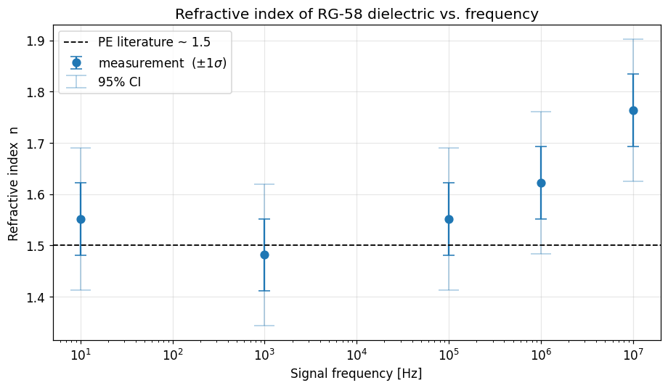

Results: n vs frequency
N vs. Frequency
Flat from 10 hz to 100 khz ($n ≈1.48 –1.55$)
Rises at 1 mhz (1.62) and 10 mhz (1.76)
Drift is at the edge of the ±1 ns resolution floor, marginal significance

Slide 8
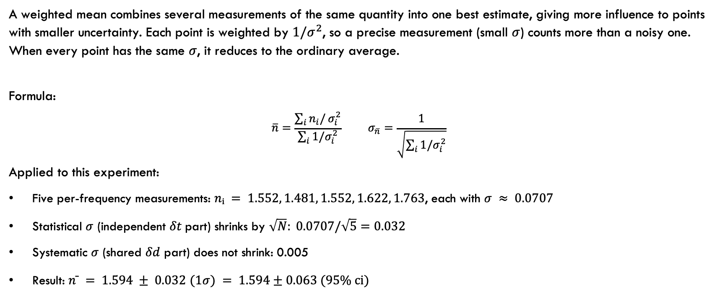
Weighted Mean
A weighted mean combines several measurements of the same quantity into one best estimate, giving more influence to points with smaller uncertainty. Each point is weighted by $1/σ^{2}$, so a precise measurement (small $σ$) counts more than a noisy one. When every point has the same $σ$, it reduces to the ordinary average.
Formula:
$\overline{n}=\frac{\sum_{i}{n_{i}/}σ_{i}^{2}}{\sum_{i}{1/σ_{i}^{2}}} σ_{\overline{n}}=\frac{1}{\sqrt{\sum_{i}{1/σ_{i}^{2}}}}$
Applied to this experiment:
Five per-frequency measurements: $nᵢ = 1.552, 1.481, 1.552, 1.622, 1.763$, each with $σ ≈ 0.0707$
Statistical $σ$ (independent $δt$part) shrinks by $\sqrt{N}: 0.0707/\sqrt{5}=0.032$
Systematic $σ$ (shared $δd$ part) does not shrink: 0.005
Result: $n ̄ = 1.594 ± 0.032$ $(1σ) = 1.594±0.063 (95\% ci)$

Slide 9
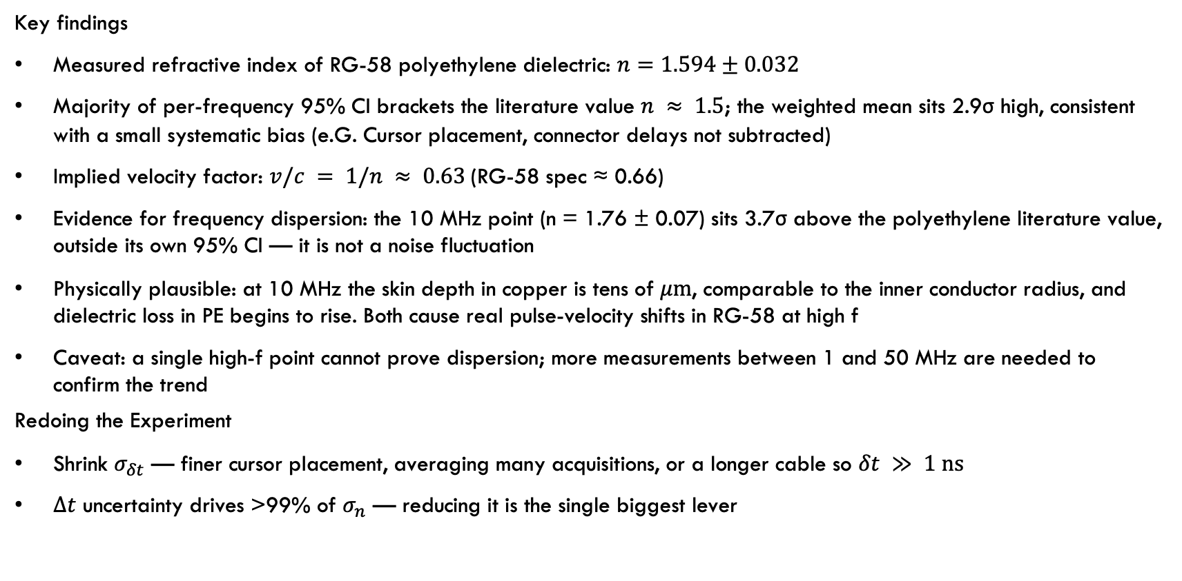
Conclusions
Key findings
Measured refractive index of RG-58 polyethylene dielectric: $n=1.594±0.032$
Majority of per-frequency 95% CI brackets the literature value $n ≈ 1.5$; the weighted mean sits 2.9σ high, consistent with a small systematic bias (e.G. Cursor placement, connector delays not subtracted)
Implied velocity factor: $v/c = 1/n ≈ 0.63$(RG-58 spec ≈ 0.66)
Evidence for frequency dispersion: the 10 MHz point (n = 1.76 ± 0.07) sits 3.7σ above the polyethylene literature value, outside its own 95% CI — it is not a noise fluctuation
Physically plausible: at 10 MHz the skin depth in copper is tens of $μ\text{m}$, comparable to the inner conductor radius, and dielectric loss in PE begins to rise. Both cause real pulse-velocity shifts in RG-58 at high f
Caveat: a single high-f point cannot prove dispersion; more measurements between 1 and 50 MHz are needed to confirm the trend
Redoing the Experiment
Shrink $σ_{δt}$ — finer cursor placement, averaging many acquisitions, or a longer cable so $δt ≫ 1 \text{ns}$
$Δt$ uncertainty drives >99% of $σ_{n}$ — reducing it is the single biggest lever

